Slide 1
Recommendation System
What is recommendation System?
Types of recommendation System
  Collaborative filtering
  Content based filtering
  Examples

Slide 2
Market basket analysis
Market Basket analysis is a technique applied by retailers to understand customer’s shopping behaviour from their stores. The result of the effective analysis may improve supplier’s profitability, quality of service and customer satisfaction

Slide 3
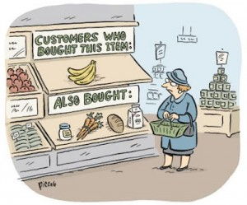
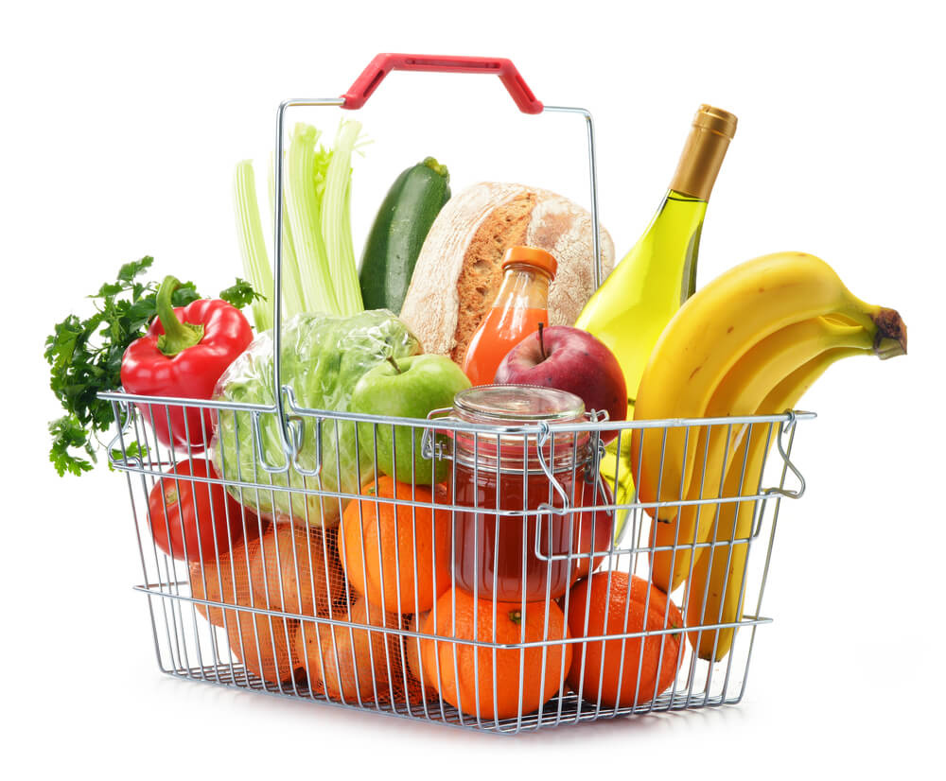
MARKET BASKET ANALYSIS

Slide 4
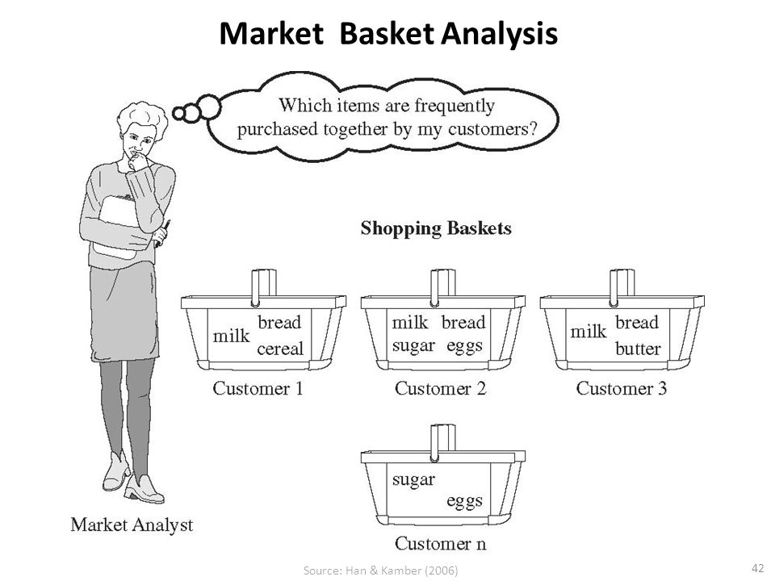
What is Market Basket Analysis
Suppose a consumer visits a store, if he /she buys product A and also product B and C.
Few more consumers visit the same store some buy product A and B only, some buy B & C only and some A & C.
Now that store manager wants to know the products sold together e.g. bread and butter.
Placing those products adjacent to each other can further increase the sales and would be ease for consumers also.
To find out these insights of consumers, Market Basket Analysis is used. It is a modelling technique based upon the theory that if a customer buys a certain group of items, he / she is more (or less) likely to buy another group of items.

Slide 5
Market Basket Analysis (MBA)
Each customer purchases different set of products, different quantities, different times
MBA uses this information to:
  Identify who customers are (not by name)
  Understand why they make certain purchases
  Gain insight about its merchandise (products):
    Fast and slow movers
    Products which are purchased together
    Products which might benefit from promotion
  Take action:
    Store layouts
    Which products to put on specials, promote, coupons…
Combining all of this with a customer loyalty card it becomes even more valuable

Slide 6
Why Market Basket Analysis
Cross Selling: Offering associated items.
Product Placement: Placing the associated items near to each other. If consumer sees them, it has higher probability that they will purchase them together.
Affinity Promotion: Designing the promotional events based on the associated products.
Fraud detection: Based on data, it may be possible to detect certain purchase behavior that can be associated with fraud.
Consumer Behavior: Associating purchase with demographic, and socio economic data (such as age, gender and preference) may produce very useful results for marketing.

Slide 7
Some Definitions
Transaction: Transactions are the group of items co-occurring together.
Confidence: It is the measure of uncertainty or trust worthiness associated with each discovered pattern. Mathematically, it is the percentage of transaction that contain both X and Y items out of all the transactions that contain X item.
Support: It is the measure of how often the collection of items in an association occur together as percentage of all transactions. For example, out of total transactions, if 60% transactions contain itemset {bread, butter}, then the support of {bread, butter} is 60%.
Frequent items: The items that appear together often enough. The term ‘often enough’ is formally defined with minimum support criterion.
Strong Association Rule: Rules that satisfy both a minimum support threshold and a minimum confidence threshold.

Slide 8
Apriori Algorithm cont.
Apriori principle:
If an itemset is frequent, then all of its subsets must also be frequent
Suppose A,B,C,D, E are items. Then total combinations possible for these items are shown in the figure. This figure illustrates how the Apriori works.
If itemset {B,C,D} is frequent, then all the subsets of this itemset, highlighted, must also be frequent itemsets. This provides the basis for Apriori algorithm.
Apriori principle holds due to the following property of the support measure:
The support of an itemset never exceeds the support of its subsets
This is known as the anti-monotone property of support

Slide 9
Apriori Algorithm cont.
The Apriori algorithm takes a bottom-up iterative approach to uncover the frequent itemsets by first determining all possible items and then identifying which among them are frequent.
Assuming the minimum support threshold (or minimum support criterion) is set at 0.5, the algorithm identifies and retains those itemsets that appear in at least 50% of all transactions and discards the itemsets that have support less than 0.5 or appear in less than 50% of the transactions.
In the next iteration, the identified frequent 1-itemsets are paired into 2-itemsets and again evaluated to identify the frequent 2-itemsets among them.
At each iteration, the algorithm checks whether the support criterion can be met; if it can, the algorithm grows the itemset, repeating the process until it runs out of support or until the itemsets reach a pre-defined length. Apriori algorithm in mathematical form is given in next slide.

Slide 10
Apriori Algorithm cont.
Let
C_{K} : Set of candidate k-itemsets
L_{K} : Set of k- itemsets that satisfy the minimum support
D : Transaction database
δ : Minimum Support threshold
N : Optional parameter indicating the maximum length an itemset could reach
Apriori iteratively computes frequent itemsets L_{k+1} based on L_{K}.
Apriori (D , δ, N)
K 1
L_{K} { 1 – itemsets that satisfy minimum support δ }
While L_{K} ≠ Ø
if Ǝ N V (Ǝ N ^ K < N)
Ck candidate itemsets generated from L

Slide 11
Apriori Algorithm
For each transaction t in database D do
Increment the counts of C_{K} contained in t
L_{K} candidates in C_{K} that satisfy minimum support
K k+1
Return U_{k}L_{k}
The first step is to identify frequent itemsets that meet the predefined minimum support threshold δ. These itemsets are 1-itemsets denoted as L₁, as each 1-itemset contains only one item.
Next, the algorithm grows the itemsets by joining L₁ onto itself to form new, grown 2-itemsets denoted as L and determines the support in each 2 itemsets in L₂. Those itemsets that do not meet minimum support threshold δ are pruned away.
Once completed, the output of algorithm is the collection all the frequent k-itemsets.

Slide 12
Example
1 | Milk | Egg | Bread
2 | Milk | Butter | Egg | Ketchup
3 | Bread | Butter | Ketchup
4 | Milk | Bread | Butter
5 | Bread | Butter | Cookies
6 | Milk | Bread | Butter | Cookies
7 | Milk | Cookies
8 | Milk | Bread | Butter
9 | Bread | Butter | Egg | Cookies
10 | Milk | Butter | Bread
11 | Milk | Bread | Butter
12 | milk | Bread | Cookies | Ketchup
Rule:
X=>y
If
Support =Freq(X,Y)/N
Confidence = freq(X,Y)/freq(X)
Support level will be set at 33% and confident level will be at 50%

Slide 13
1 | Milk | Egg | Bread
2 | Milk | Butter | Egg | Ketchup
3 | Bread | Butter | Ketchup
4 | Milk | Bread | Butter
5 | Bread | Butter | Cookies
6 | Milk | Bread | Butter | Cookies
7 | Milk | Cookies
8 | Milk | Bread | Butter
9 | Bread | Butter | Egg | Cookies
10 | Milk | Butter | Bread
11 | Milk | Bread | Butter
12 | milk | Bread | Cookies | Ketchup
1st item set | Frequency
Milk | 9
Bread | 10
Butter | 10
Egg | 3
Ketchup | 3
Cookies | 5
Frequency 1 item set | Frequency
Milk | 9
Bread | 10
Butter | 10
Cookies | 5
Frequent 1 item set:
This is the item set which supports the minimum support level
Minimum support we required 30%
For egg and ketchup 3/12 = 0.25
For Cookies 5/12 = 0.41

Slide 14
2 item set
2nd item set | Frequency
Milk, bread | 7
Milk, butter | 7
Milk , Cookies | 3
Bread, butter | 9
Butter , Cookies | 3
Bread Cookies | 4
Frequency 2 item sets | Frequency
Milk ,bread | 7
Milk , butter | 7
Bread, butter | 9
Bread , cookies | 4

Slide 15
3 item set
Milk, Bread, Butter, Cookies
3 item set | Frequency
Milk, bread, butter | 6
Milk, bread, cookies | 1
Bread, butter, Cookies | 3
Milk , butter, Cookies | 2
Frequent 3 item sets | Frequency
Milk, bread, butter | 6
We can not form the 4 item set as we are having only single occurrence of 3 item set

Slide 16
Association rule Mining
Frequent 3 item set = I => {Milk, Bread, Butter}
Non-Empty subsets are:
  {{Milk},{Bread},{Butter},{Milk, Bread},{Milk, butter}, {Bread, Butter}}
How to form association rule:
  For every non-empty subset S of I , the association rule is
  S -> (I-S)
  {Milk} -> {{{Milk},{Bread},{Butter}} - {Milk}} -> {{Bread},{Butter}}
  If support (I)/support(S) >= min confidence

Slide 17
Association rule Mining – Subset Creation
Non empty subsets are
  {{Milk},{Bread},{Butter},{Milk, Bread},{Milk, butter}, {Bread, Butter}}
  Min_support = 30% and min_confidence = 60%
Rule1: {Milk} -> {Bread, Butter} {S = 50%, C = 66.67%}
  Support: 6/12 =50%
  Confidence : support(milk, bread, butter) / support(milk) = (6/12) / (9/12) = 6/9 =66. 67% > 60%
Rule2: {Bread} -> {Milk, Butter} {S = 50%, C = 66.67%}
  Support: 6/12 =50%
  Confidence : support(milk, bread, butter) / support(bread) = (6/12) / (10/12) = 6/10 =69% > 60%
Rule3: {Butter} -> {Milk, Bread} {S = 50%, C = 66.67%}
  Support: 6/12 =50%
  Confidence : support(milk, bread, butter) / support(butter) = (6/12) / (10/12) = 6/10 =69% > 60%

Slide 18
Association rule Mining – Subset Creation
Rule4: {Milk, Bread} -> {Butter}{S = 50%, C = 66.67%}
  Support: 6/12 =50%
  Confidence : support(milk, bread, butter) / support(Milk, Bread) = (6/12) / (7/12) = 6/7 = 85% > 60%
Rule5: {Milk, Butter} -> {Bread} {S = 50%, C = 66.67%}
  Support: 6/12 =50%
  Confidence : support(milk, bread, butter) / support(Milk, butter) = (6/12) / (7/12) = 6/7 = 85% > 60%
Rule6: {Bread ,Butter} -> {Milk} {S = 50%, C = 66.67%}
  Support: 6/12 =50%
  Confidence : support(milk, bread, butter) / support(Bread ,butter) = (6/12) / (9/12) = 6/9 = 66.67% > 60%

Slide 19
Applications of Association Rules
Broad-scale approaches to better merchandising – what products should be included or excluded from the inventory each month.
Cross-merchandising between products and high-margin high ticket items.
Physical or logical placement of product within related categories of products.
Promotional programs – multiple product purchase incentives managed through a loyalty card program
Apart from market Basket analysis, association rules are also commonly used for recommender systems (Amazon and Netflix) and clickstream (web browsing user clicks) analysis.

Slide 20
Use Case - description
Mike is store manager of a Multi brand retail store. He has access to the transactions data stored every time a customer buys something from his stores. He knew by experience that certain products are often bought together but with huge variety of products available, he wanted to perform some statistical test to capture the insightful association available in the transaction records available in his database.
He had plans to re-design the store layout so that customers find the associated products next to each other. He wanted to rethink over the offers and promotions to ensure that they make sense to the customers. Finally, this basket analysis will help him proactively recommend “What else” and “What next” to his loyal customers.
Mike will perform Market basket analysis and based on the output results, plan his store layout, promotions and recommendations.

Slide 21
Recommendation

Slide 22
Types of Recommendation system
Collaborative Filtering
Content based filtering
Hybrid-Combination of the Collaborative and content based
Popularity based: e.g. most Downloaded, Most watched, Most bought,

Slide 23
Content based filtering
Machine Learning uses similarities in features to make the decision
Algorithms designed to advertise or recommend things to user based on the knowledge about user
Based on the content and liking of the customer, next recommendation will be given
Compare user interest and product features
Most overlapping features with user interest are what’s recommended
E.g. Book, movie genres
Methodology for content based filtering:
There are two methods for content based filtering
User can be given list of features, out of which they can choose whatever they identified the most
The algorithm can keep track of products the user has chosen before and add those features to the user data.
Formula to calculate user interest:
User interest level = ∑ (pi, ui)
Pi is the product feature values in column i
Ui is the user interest value in column i

Slide 24
Problem Statement
Travel booking website books thousands of hotel rooms everyday
With such a huge growth, the task is to improve the booking per customer by showing the best hotels as per the taste and preferences of the user.
Hotel 1 | Good gym, Small Pool
Hotel 2 | Amazing Gym, No Pool
Hotel 3 | Great Gym and Small Pool
Hotel 4 | Basic Gym and Large Pool
Hotel 5 | No Gym and large designer pool

Slide 25
Feature Matrix
Item Feature Matrix
Hotel | Gym | Pool
Hotel1 | 0.8 | 0.2
Hotel2 | 1 | 0
Hotel3 | 0.9 | 0.1
Hotel4 | 0.1 | 0.9
Hotel5 | 0 | 1

Slide 26
Customer Liking
A: More Preference to gym than the swimming pool
B: Likes Gym more than the pool
C: Need pool with basic gym
D: A pool is must compared to gym
User | Gym | Pool
A | 0.9 | 0.1
B | 0.8 | 0.2
C | 0.3 | 0.7
D | 0 | 1

Slide 27
Create Feature vector
Hotel | Gym | Pool
Hotel1 | 0.8 | 0.2
Hotel2 | 1 | 0
Hotel3 | 0.9 | 0.1
Hotel4 | 0.1 | 0.9
Hotel5 | 0 | 1
Hotel | Feature Vector
Hotel1 | [0.8, 0.2]
Hotel2 | [1, 0]
Hotel3 | [0.9, 0.1]
Hotel4 | [0.1, 0.9]
Hotel5 | [0,1]
User | Gym | Pool
A | 0.9 | 0.1
B | 0.8 | 0.2
C | 0.3 | 0.7
D | 0 | 1
User | Feature Vector
A | [0.9, 0.1]
B | [0.8, 0.2]
C | [0.3, 0.7]
D | [0,1]

Slide 28
Content Based Recommendation
Hotel | Feature Vector
Hotel1 | [0.8, 0.2]
Hotel2 | [1, 0]
Hotel3 | [0.9, 0.1]
Hotel4 | [0.1, 0.9]
Hotel5 | [0,1]
User | Feature Vector
A | [0.9, 0.1]
B | [0.8, 0.2]
C | [0.3, 0.7]
D | [0,1]
Which hotel should be suggested to User A?
Max(Uj* Hi)
MAX(A*H1, A*H2, A*H3, A*H4, A*H5)
What is vector product ?
A*H1= [0.9*0.8+0.2*0.1]
Finally output of all is max(0.74, 0.9, 0.82, 0.18, 0.1)
And recommendation is hotel 2 to User A

Slide 29
Pros and Cons
Pros:
  Easily scalable due to low amount of data
  Unlike other models, this does not compare with other users data
Cons:
  Model requires a fair amount of domain based knowledge
  Content based filtering depends on previous known user interest.

Slide 30
Collaborative Filtering
Analysis user behavior, activities, and preferences
Recommended based on similarity to other user
Model keeps the track of what product users like and their characteristics
Product should be given numerical values
People who agreed in the past will agree in future
e.g. milk and bread are bought together
Methodology:
There are two ways the model can identify whether or not user enjoyed the product
The user can be asked to give a numerical rating or the system can assume that the user likes whatever product they use,

Slide 31
Collaborative Filter
User expresses preferences by rating the item
Rating can be viewed as an approximate representation of the user’s interest in the corresponding domain
The system matches user’s ratings against other user’s and find the people with similar tastes.
With similar users, the system recommends items that the similar users have rated highly but not yet being rated by this user
user | Hotel1 | hotel2 | Hotel3 | Hotel4 | Hotel6
A | 4 | 5 | ? | ? | 1
B | ? | 5 | 4.5 | ? | 1
C | 2 | 3 | ? | 5 | 4
D | 1 | ? | ? | ? | 5

Slide 32
Issue with Recommendation
Cold start
Same scale Judgment

Slide 33
Cold start
Content based filtering constructs user profile before system can recommend.
Collaborative filtering needs like minded users for recommendation
Completely new profile or item
Can be tackled using hybrid recommendation.

Slide 34
Same scale judgement
A user rates all the items on a same scale
An item is rated on the same scale by all users

Slide 35
Thank you

Slide 36
Step by step approach
Three types of data is required:
Ratings
Users
Item-features

Slide 37
NDCG: Normalized Discounted Cumulative Gain

